Slide 1
Cipher Block - Modes of Operation

Slide 2
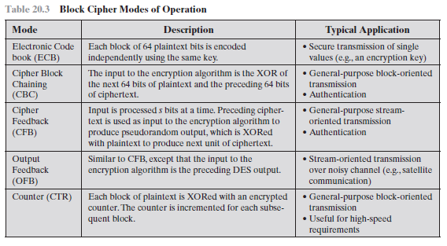
Cipher Block Modes of Operation

Slide 3
Electronic Codebook Mode
Symmetric encryption is applied to a unit of data larger than a single 64-bit or 128-bit block.
E-mail messages, network packets, database records, and other plaintext sources must be broken up into a series of fixed length block for encryption by a symmetric block cipher.
The simplest approach to multiple-block encryption is known as electronic codebook (ECB) mode, in which plaintext is handled ‘b’ bits at a time and each block of plaintext is encrypted using the same key. Typically b = 64 or b = 128.

Slide 4
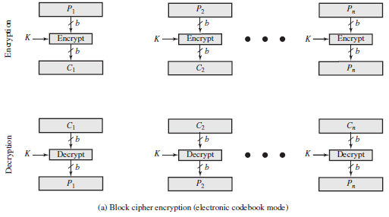
Electronic Codebook Mode
Figure 2.2a shows the ECB mode. A plain text of length ‘nb’ is divided into n b-bit blocks (P1, P2,c, Pn). Each block is encrypted using the same algorithm and the same encryption key, to produce a sequence of n b-bit blocks of ciphertext (C1, C2,c, Cn)..
To increase the security of symmetric block encryption for large sequences of data, a number of alternative techniques have been developed, called modes of operation. These modes overcome the weaknesses of ECB.

Slide 5
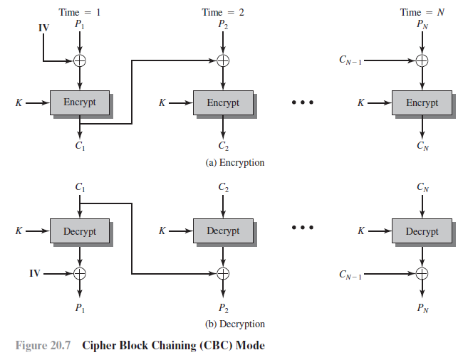
Cipher Block Chaining Mode
Input to the encryption algorithm is the XOR of the current plaintext block and the preceding ciphertextblock; the same key is used for each block.we have chained together the processing of the sequence of plaintext blocks.

Slide 6
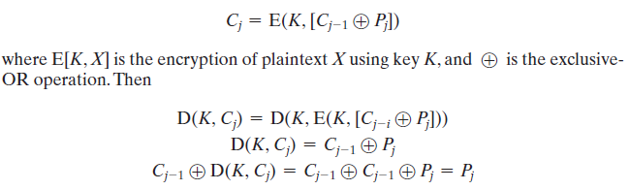
Cipher Block Chaining Mode
For decryption, each cipher block is passed through the decryption algorithm. The result is XORed with the preceding ciphertext block to produce the plaintext block.
To produce the first block of ciphertext, an initialization vector (IV) is XORed with the first block of plaintext. On decryption, the IV is XORed with the output of the decryption algorithm to recover the first block of plaintext.
The IV must be known to both the sender and receiver. For maximum security, the IV should be protected as well as the key. One reason for protecting the IV is as follows: If an opponent is able to fool the receiver into using a different value for IV, then the opponent is able to invert selected bits in the first block of plaintext

Slide 7
Cipher Feedback Mode
It is possible to convert any block cipher into a stream cipher by using the cipher feedback (CFB) mode.
A stream cipher eliminates the need to pad a message to be an integral number of blocks.
If a character stream is being transmitted, each character can be encrypted and transmitted immediately using a character-oriented stream cipher.
One desirable property of a stream cipher is that the ciphertext be of the same length as the plaintext.

Slide 8
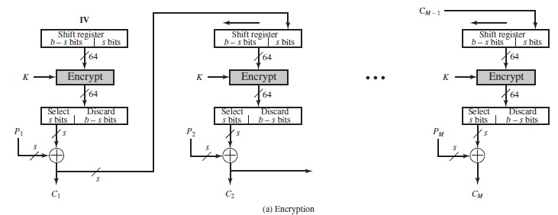
Cipher Feedback Mode
First, consider encryption. The input to the encryption function is a b-bit shift register that is initially set to some initialization vector (IV).
Leftmost (most significant) s bits of the output of the encryption function are XORed with the first unit of plaintext P1 to produce the first unit of ciphertext C1, which is then transmitted.
Contents of the shift register are shifted left by s bits and C1 is placed in the rightmost (least significant) s bits of the shift register. This process continues until all plaintext units have been encrypted.

Slide 9
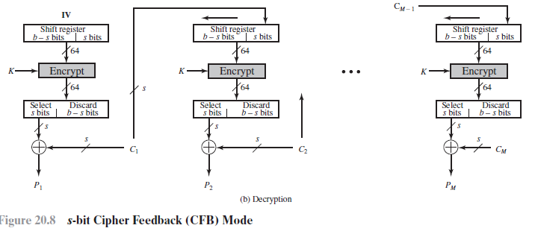
Cipher Feedback Mode
For decryption, the same scheme is used, except that the received ciphertext unit is XORed with the output of the encryption function to produce the plaintext unit. Note that it is the encryption function that is used, not the decryption function.
This is easily explained. Let Ss(X) be defined as the most significant s bits of X.

Slide 10
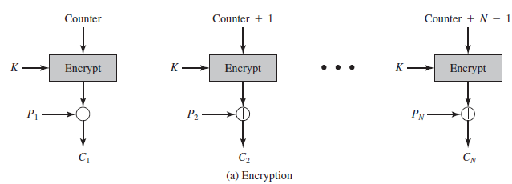
Counter Mode
A counter equal to the plaintext block size is used. The only requirement stated is that the counter value must be different for each plaintext block that is encrypted.
counter is initialized to some value and then incremented by 1 for each subsequent block (modulo 2b, where b is the block size). For encryption, the counter is encrypted then XORed with the plaintext block to produce the ciphertext block; there is no chaining.

Slide 11
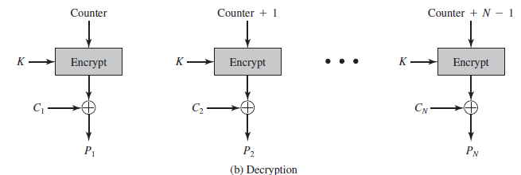
Counter Mode
For decryption, the same sequence of counter values is used, with each encrypted counter XORed with a ciphertext block to recover the corresponding plaintext block.

Slide 12
Counter Mode
Following advantages of CTR mode:
Hardware Efficiency: Unlike the three chaining modes, encryption (or decryption) in CTR mode can be done in parallel on multiple blocks of plaintext or ciphertext.
Algorithm must complete the computation on one block before beginning on the next block. This limits the maximum throughput of the algorithm to the reciprocal of the time for one execution of block encryption or decryption.
Throughput is only limited by the amount of parallelism that is achieved.
Software Efficiency: Similarly, because of the opportunities for parallel execution in CTR mode, processors that support parallel features, such as aggressive pipelining, multiple instruction dispatch per clock cycle, a large number of registers, and SIMD instructions, can be effectively utilized.

Slide 13
Counter Mode
Preprocessing: The execution of the underlying encryption algorithm does not depend on input of the plaintext or ciphertext.
If sufficient memory is available and security is maintained, preprocessing can be used to prepare the output of the encryption boxes that feed into the XOR functions. When the plaintext or ciphertext input is presented, then the only computation is a series of XORs. Such a strategy greatly enhances throughput.
Random Access: The ith block of plaintext or ciphertext can be processed in random access fashion.
With the chaining modes, block Ci cannot be computed until the i - 1 prior block are computed. There may be applications in which a ciphertext is stored and it is desired to decrypt just one block; for such applications, the random access feature is attractive.

Slide 14
Counter Mode
Provable Security: It can be shown that CTR is at least as secure as the other modes discussed in this section.
Simplicity: Unlike ECB and CBC modes, CTR mode requires only the implementation of the encryption algorithm and not the decryption algorithm.
the decryption algorithm differs substantially from the encryption algorithm, as it does for AES. In addition, the decryption key scheduling need not be implemented.

Slide 15
Classical Cryptography

Slide 16
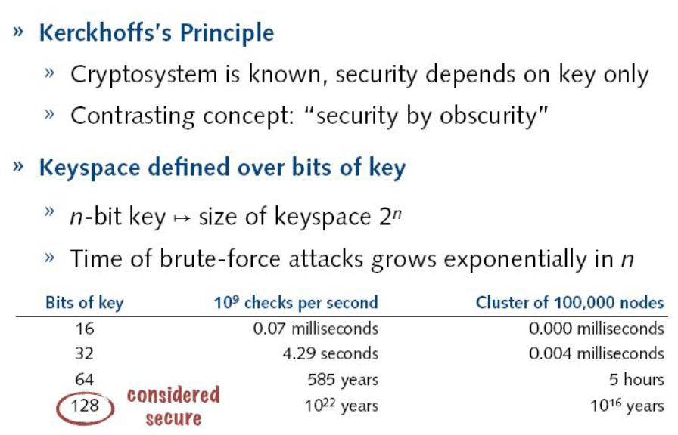
Kerchoff’s Principle

Slide 17
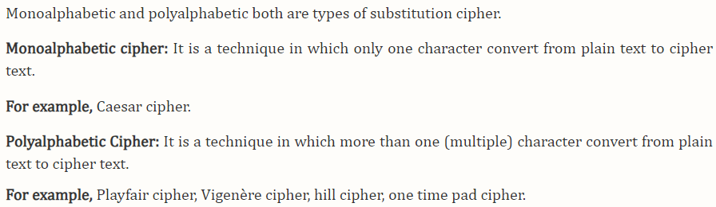
Substitution Cipher

Slide 18
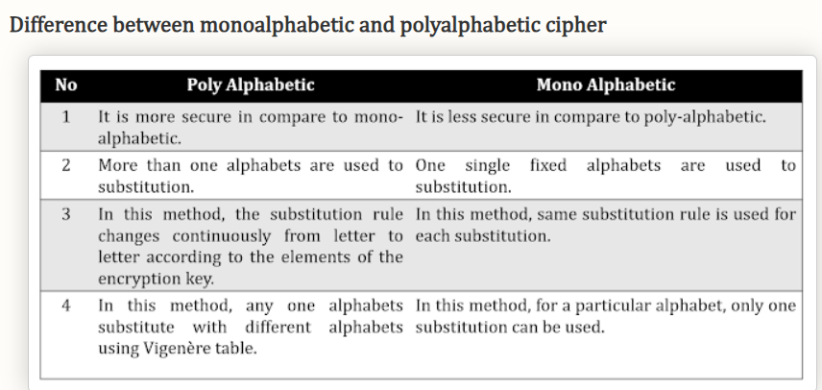
Cryptosystems

Slide 19
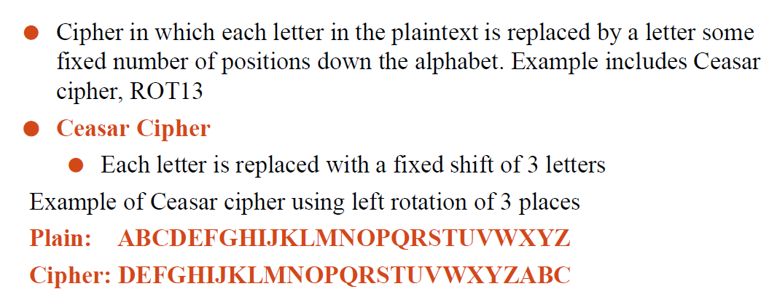
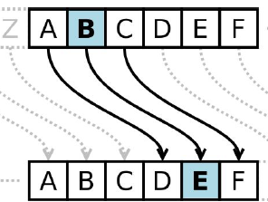
Shift Cipher

Slide 20
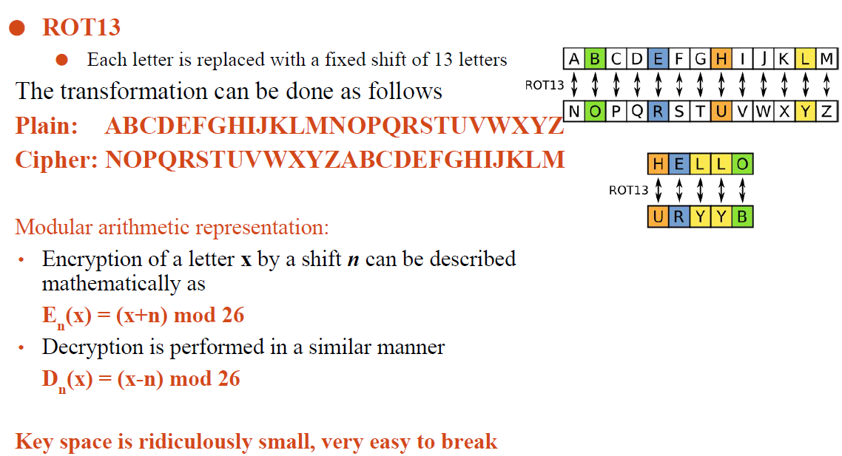
Shift Cipher (RTO 13)

Slide 21
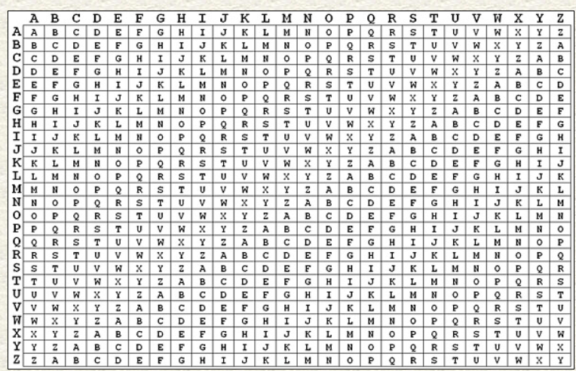
Vigenere Cipher
The Vigenère cipher is a method of encrypting alphabetic text where each letter of the plaintext is encoded with a different Caesar cipher, whose increment is determined by the corresponding letter of another text, the key.

Slide 22
One Time Pad
One Time Pad algorithm is the improvement of the Vernam Cipher. It is a method of encrypting alphabetic plain text. It is one of the Substitution techniques which converts plain text into ciphertext. In this mechanism, we assign a number to each character of the Plain-Text.
The two requirements for the One-Time pad are
The key should be randomly generated as long as the size of the message.
The key is to be used to encrypt and decrypt a single message, and then it is discarded.

